Slide 1
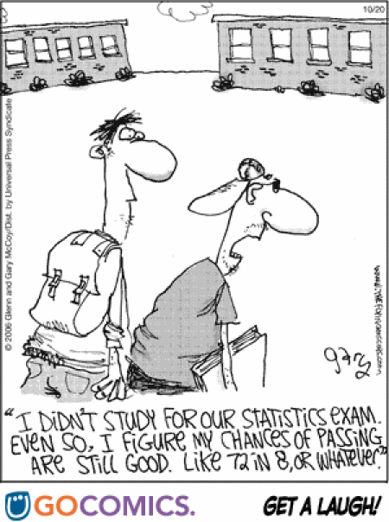

Probability and Probability Distribution

Slide 2
Probability
Probability is a measure of how likely an event is to occur.
For example –
Today there is a 30% chance of rain.
Probabilities are written as:
Decimals from 0 to 1
Percent from 0% to 100%

Slide 3
Probability
If an event is certain to happen, then the probability of the event is 1 or 100%.
If an event will NEVER happen, then the probability of the event is 0 or 0%.
If an event is just as likely to happen as to not happen, then the probability of the event is ½, 0.5 or 50%.
Impossible Unlikely Equal Chances Likely Certain
0 0.5 1
0% 50% 100%
½

Slide 4
What is a PROBABILITY?
0% 25% 50% 75% 100%
0 ¼ or .25 ½ 0r .5 ¾ or .75 1
Impossible Not Very Equally Likely Somewhat Certain
Likely Likely

Slide 5
Probability
When a meteorologist says that the chance of rain is 50%, the meteorologist is predicting that it is equally likely to rain or not to rain.
If the chance of rain rises to 80%, it is more likely to rain.
If the chance drops to 20%, then it may rain, or it probably will not rain.

Slide 6
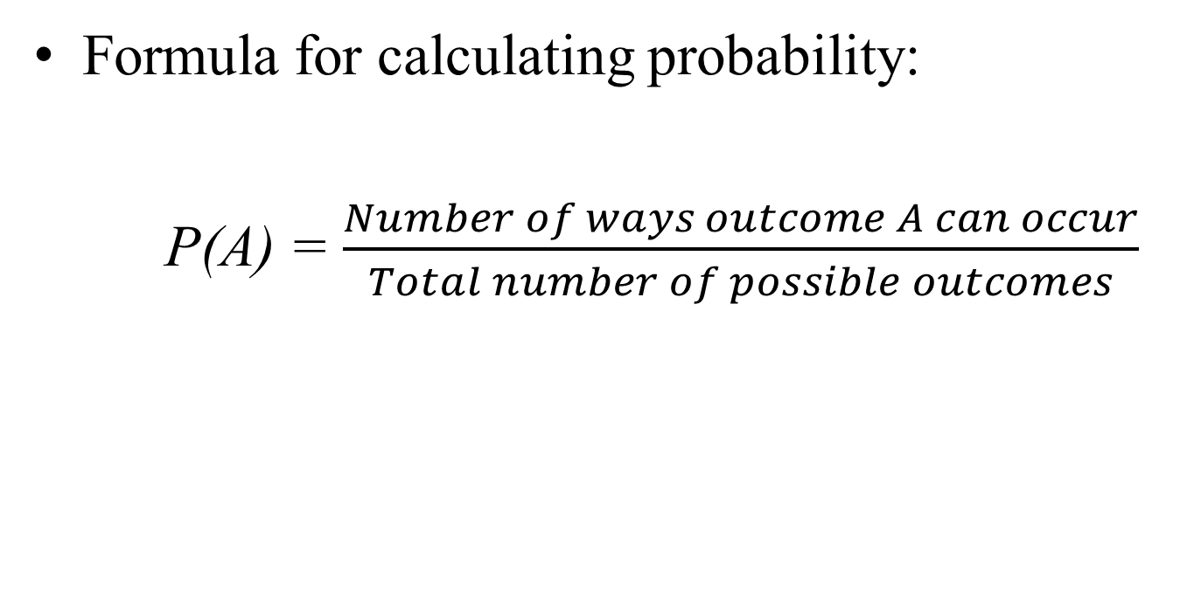
Formula for calculating probabilities
Formula for calculating probability:
P(A) = $\frac{Number of ways outcome A can occur}{Total number of possible outcomes}$

Slide 7

Spinners.
What is the probability of spinning green?
# favorable outcomes
# possible outcomes
1 1
4 4
The probability of spinning green is 1 out of 4 or .25 or 25%
P(event) =
P(green) = =

Slide 8
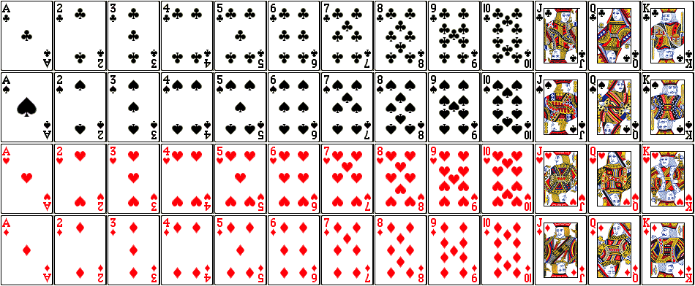
A deck of cards

Slide 9

Deck of Cards.
What is the probability of picking a heart?
# favorable outcomes 13 1
# possible outcomes 52 4
The probability of picking a heart is
1 out of 4 or .25 or 25%
What is the probability of picking a non heart?
# favorable outcomes 39 3
# possible outcomes 52 4
The probability of picking a heart is
3 out of 4 or .75 or 75%
P(heart) = =
P(non-heart) = =

Slide 10
Probability
Example
If the coin is tossed in the air, the chances or probability of getting head or tail is equal
If p = head and q = tail then the probability of obtaining event p is:
P(p) + P(q) = 1
Since the number of ways that p can be an outcome is just 1 and the number of outcome possible is 2 (p or q), the possibility of p occurring is 1 / 2 = 0.5
Probability of q as outcome is similarly the same: 1 / 2 = 0.5
In our case: 0.5 + 0.5 = 1

Slide 11
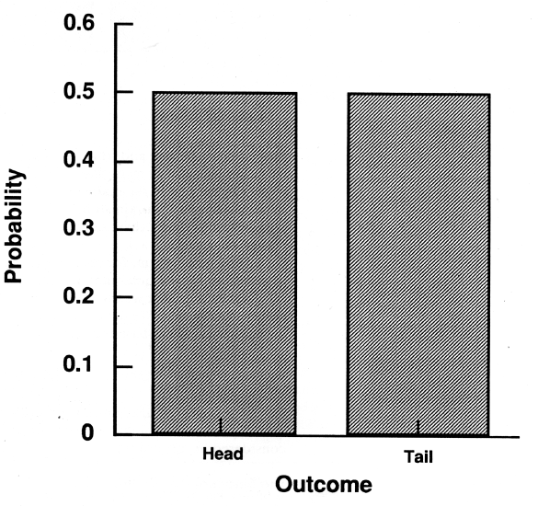
Probability Distribution
Probability distribution?
A probability distribution is a listing of probabilities in a table or graph
Outcome Probability
Head 0.5
Tail 0.5

Slide 12
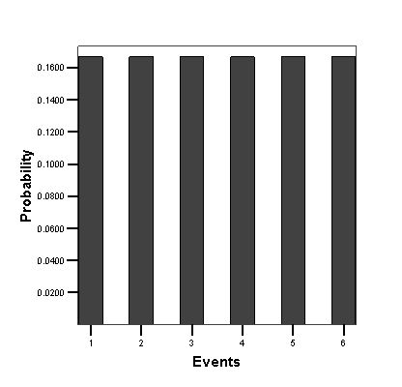
Probability and Probability Distribution
Example
Consider a roll of a dice. The probability of getting an event 1 is 1 / 6 = 0.1666 (6 is the total possible outcomes in dice)
Probability for other numbers 2, 3, 4, 5, & 6 is similar, i.e., 1 / 6 = 0.1666, as each number has one possible outcome only

Slide 13
The rules of probability: The complementary probability rule
Complementary probability: is the probability of an outcome not occurring.
If p(A) is the probability of outcome A occurring, then p(Ǡ) is the complementary probability of any outcome other than A occurring.
For example; if two coins are tossed, what is the probability of something other than two heads turning up?
Outcomes:
The first ‘head’ and the second ‘head’ (HH).
The first ‘head’ and the second ‘tail’ (HT).
The first is ‘tail’ and the second ‘head’ (TH).
The first is ‘tail’ and the second ‘tail’ (TT).
The total number of possible outcome = 4; if HH is expected, then the probability = ¼.

Slide 14
Contd.. (complimentary probability)
The probability of something other than two heads turning up; p(Ǡ) = 1.00 - .25 = .75
The addition rule I: the probability of two outcomes occurring when outcomes are mutually exclusive.
If two coins are tossed, what is the probability of getting two heads or two tails? This can be calculated by adding together two separate probabilities (the probability of two heads and two tails):
p(A or B) = p(A) + p(B)
p(two heads or two tails) = .25+.25 = .50
where p(A or B) = probability of either of two mutually exclusive outcomes occurring, p(A) the probability of outcome A occurring and, p(B) the probability of outcome B occurring.

Slide 15
The addition rule II: the probability of two outcomes occurring when outcomes are not mutually exclusive.
Imagine a deck of cards, what is the probability if a person selects a card at random, of the card being ace or a heart?
There are 52 cards in a deck and 4 out of them are aces, so the probability of selecting the ace is 4/52 = ? There are 13 hearts in a deck so the probability of selecting a heart is 13/52 = ?
But these events are not mutually exclusive as an ace an a heart can jointly occur and the probability of selecting the ace of heart is 1/52 = ?
Add together the mutually exclusive and then subtract the joint occurrence:
p(an ace or a heart) = 4/52+13/52-1/52 = .31 or 31% probability

Slide 16
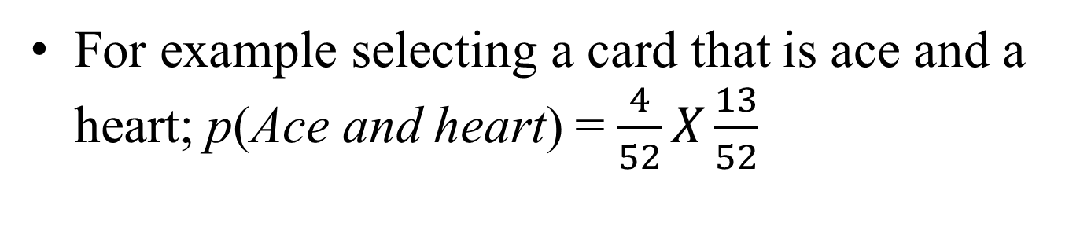
The Multiplication rule: Calculate the probability of two independent events
For example selecting a card that is ace and a heart; p(Ace and heart) = $\frac{4}{52}X\frac{13}{52}$
= .02

